Slide 1

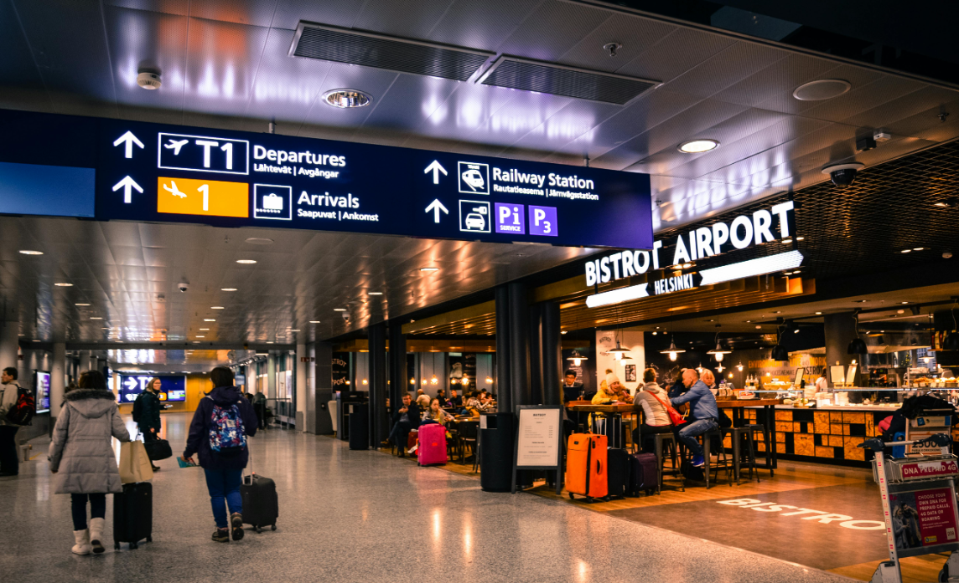
PREDICTING
FLIGHT DELAYS
AN EXPLORATORY DATA ANALYSIS
CAPSTONE PROJECT BY
PARTH THAKER

Slide 2
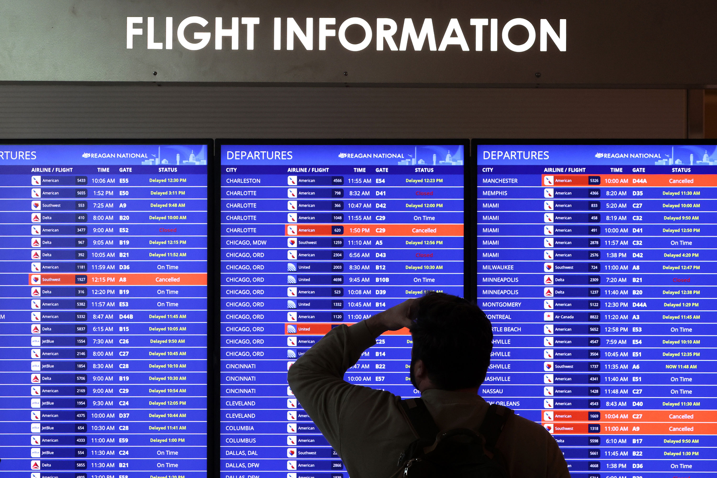
OVERVIEW
01
02
03
About
Dataset and Process
Key Statistics
04
05
06
Data Visualization
Predictor Tool
Final Comments

Slide 3
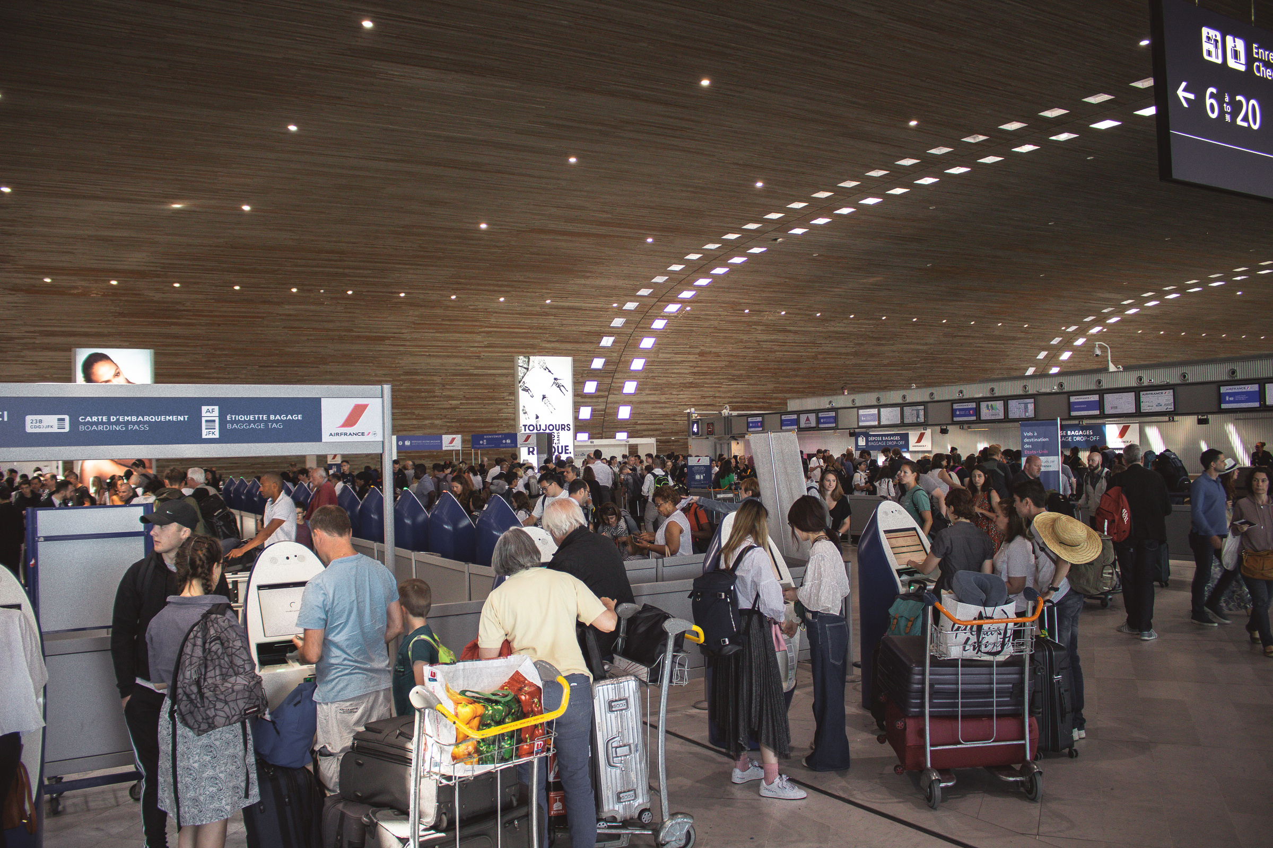
About
This project aims to build predictive models to forecast airline delays using flight data from 2019-2023 and analyze the dataset by using different ML Models.
By analyzing flight schedules, weather conditions, and airline operations, the goal is to uncover key factors causing delays and provide actionable insights. These insights are designed to help airlines, airports, and passengers better prepare for and minimize disruptions, improving travel efficiency and experience.

Slide 4


DATASET
The dataset for this project was sourced from Kaggle, a platform for data science and machine learning. It is titled "Flight Delay and Cancellation Data" and covers the years 2019-2023.
Processed Dataset
01
Dataset is first loaded using the read_csv library. The dataset includes flight information from the year 2019-2023, encompassing over 2 million records
Encoding Categorical variables
02
The dataset was further explored to examine its structure and identify any missing values. Rows with missing data in key columns were removed to ensure the dataset's reliability.
Categorical variables, including 'AIRLINE,' 'ORIGIN,' 'DEST,' and 'CRS Time,' were encoded for analysis and the data was cleaned to make it easier to process.
Handling Missing Values and Pre-Processing
03
04
Feature engineering was performed and new features were created, such as categorizing delays into short, medium, and long durations. Additionally, time-based features, such as departure hour and day of the week, were extracted to capture temporal patterns that could impact delays.
Data Loading and Inspection

Slide 5
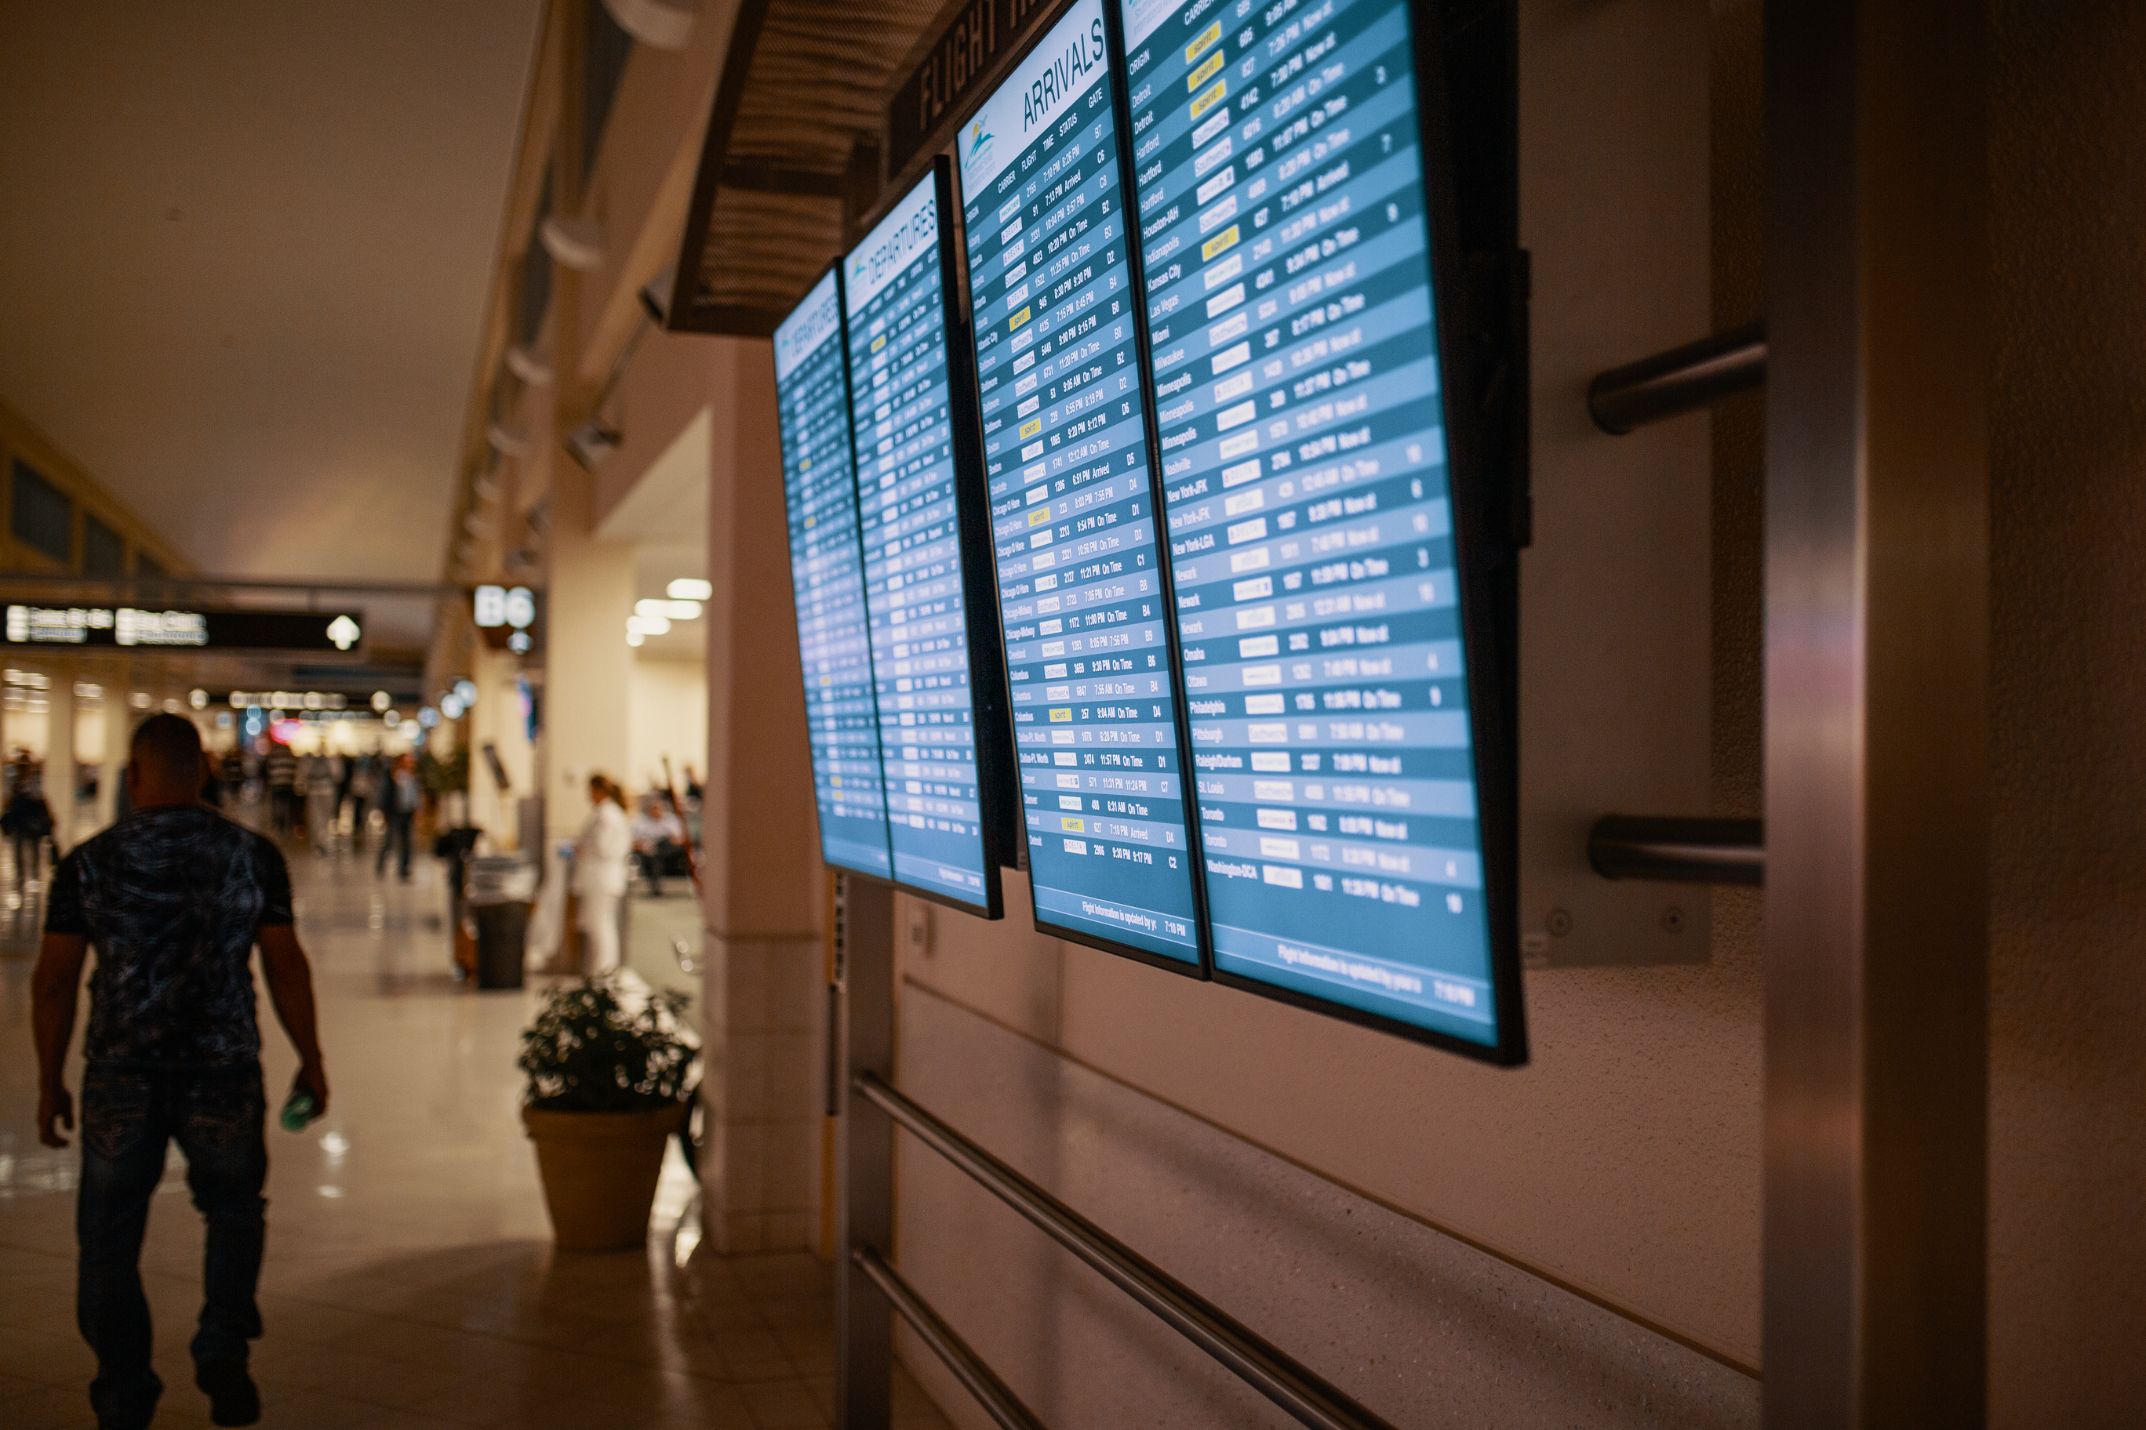




DATA AT A GLANCE
TOTAL AIRLINES
TOTAL AIRPORTS
TOTAL FLIGHTS
18
369
1704
TOTAL NUMBER OF VARIABLES
DATA RECORDS
32
2
M
such as flight number, carrier, origin, delay by causes etc

Slide 6

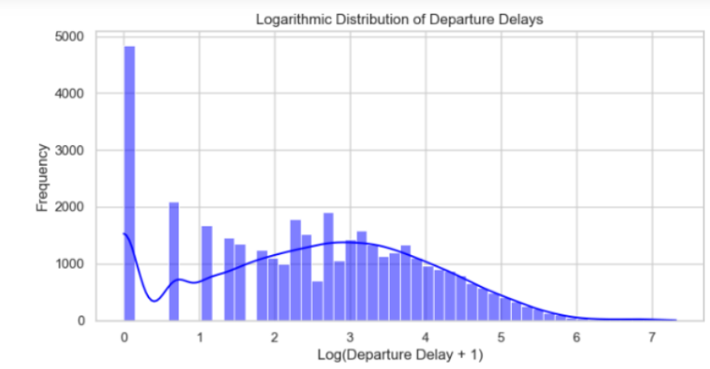
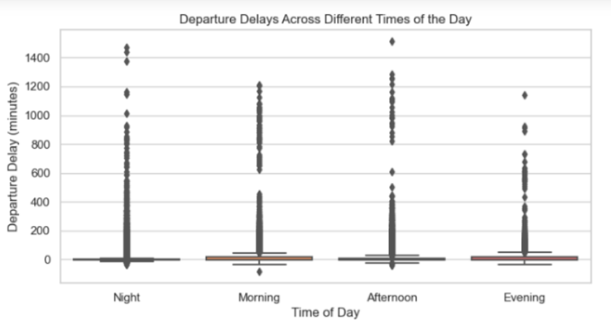
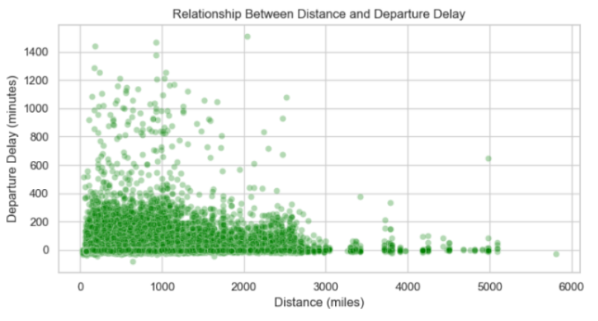
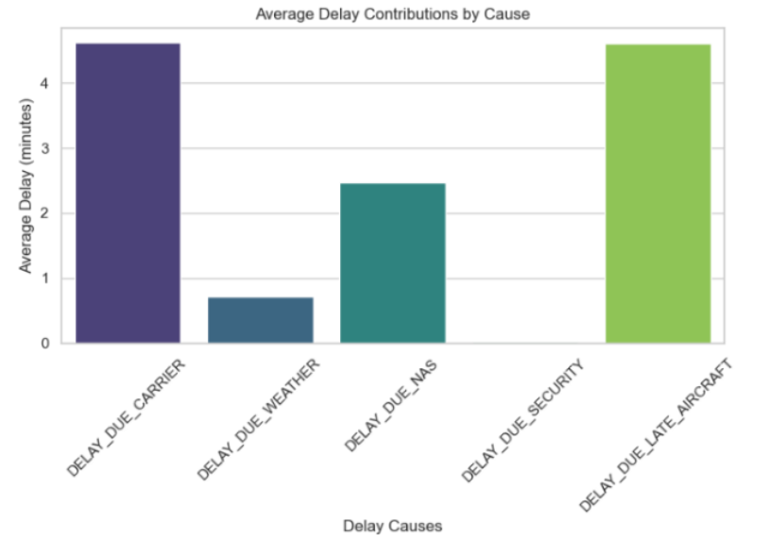
Exploratory Data Analysis

Slide 7
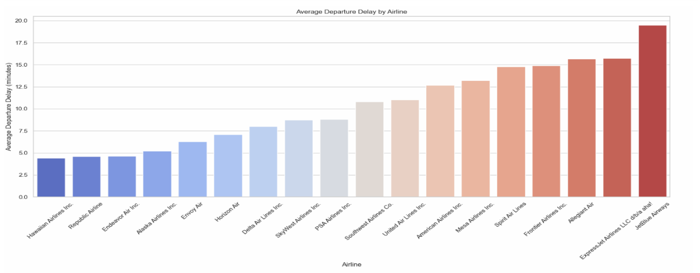
Analyzing Trends For Airlines
The bar chart displays the average departure delay for each airline, sorted in ascending order. The variation in delays across airlines indicates differences in operational performance, flight scheduling, and resource management. Airlines with consistently lower delays can serve as benchmarks for operational efficiency, while those with higher delays highlight areas for improvement.

Slide 8
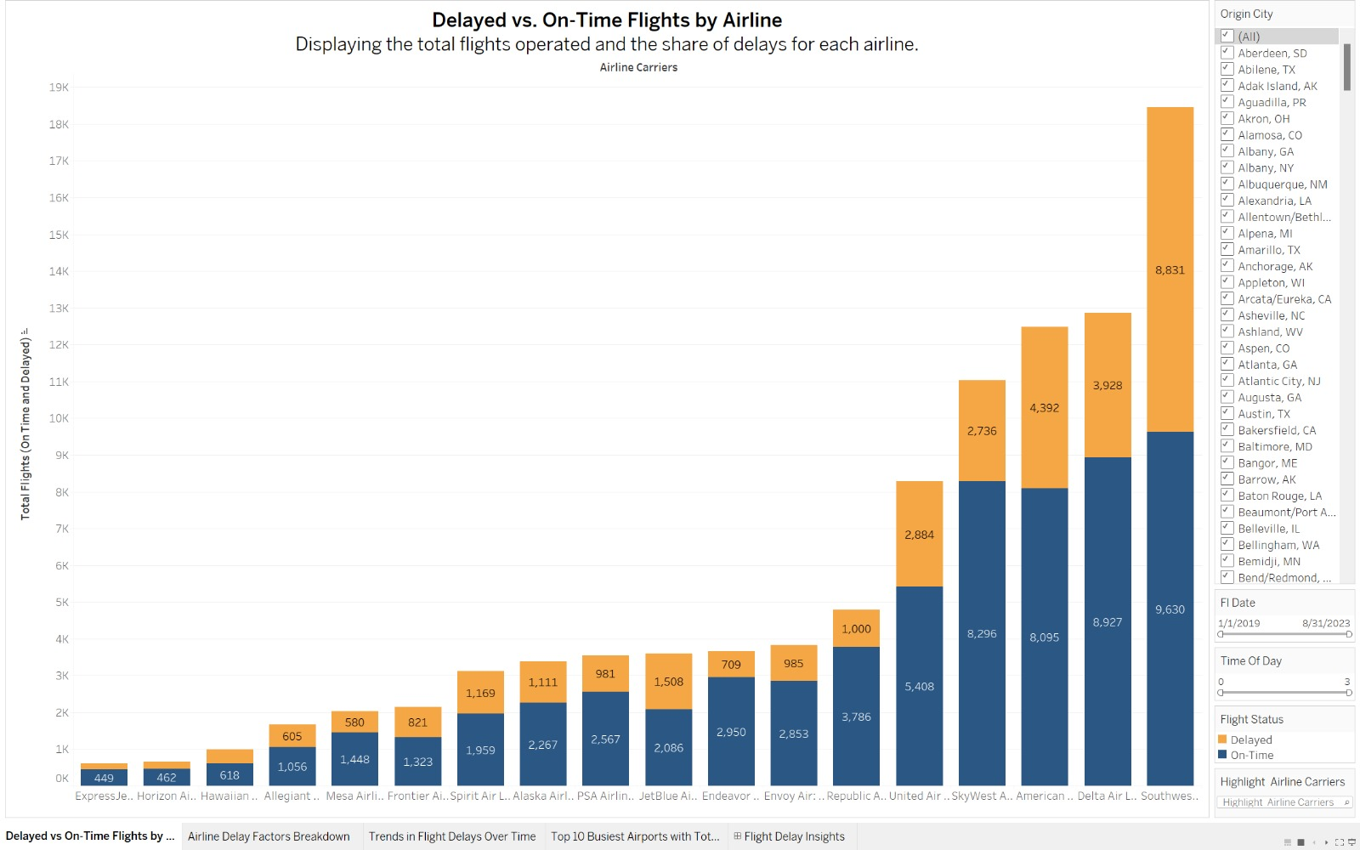

DATA VISUALIZATIONS

Slide 9
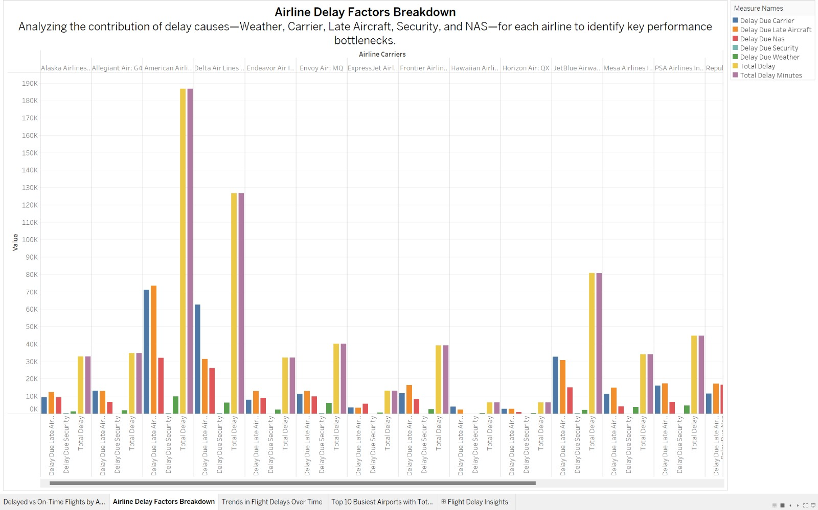
DATA VISUALIZATIONS

Slide 10
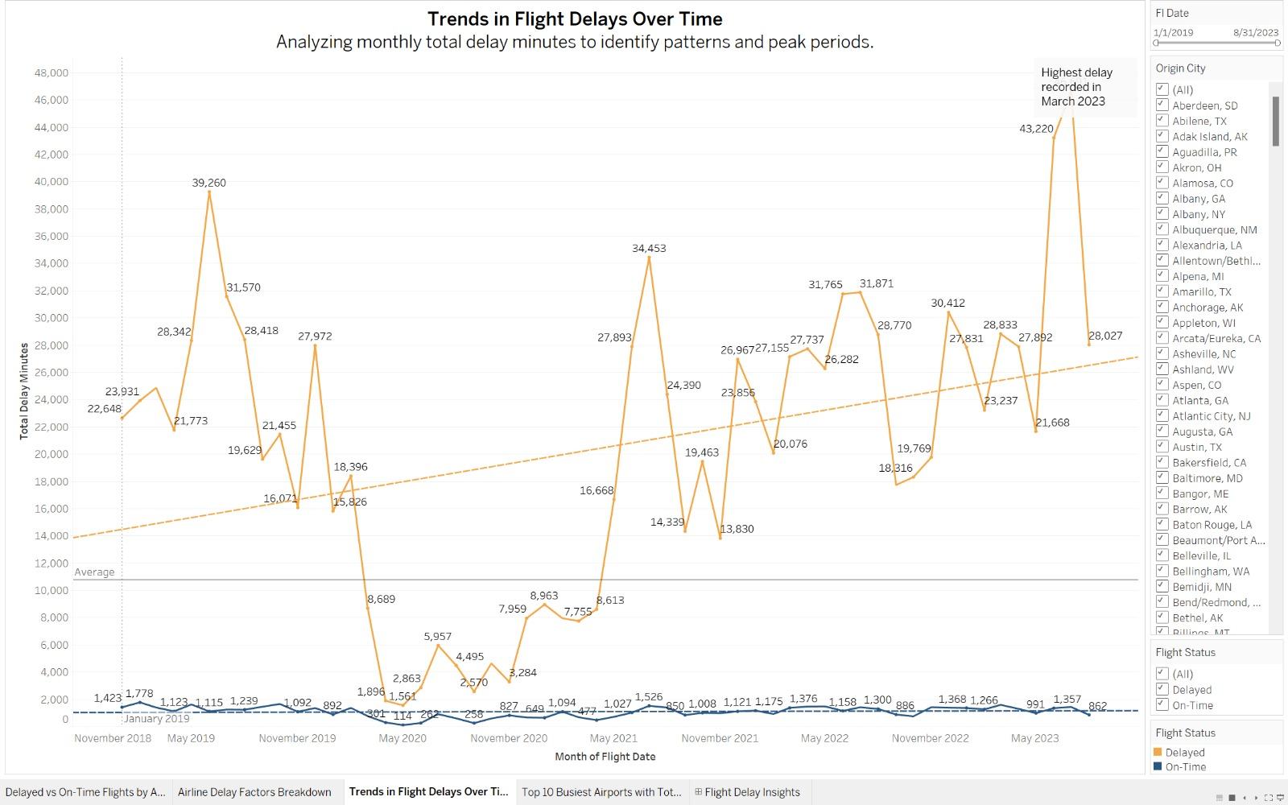
DATA VISUALIZATIONS

Slide 11
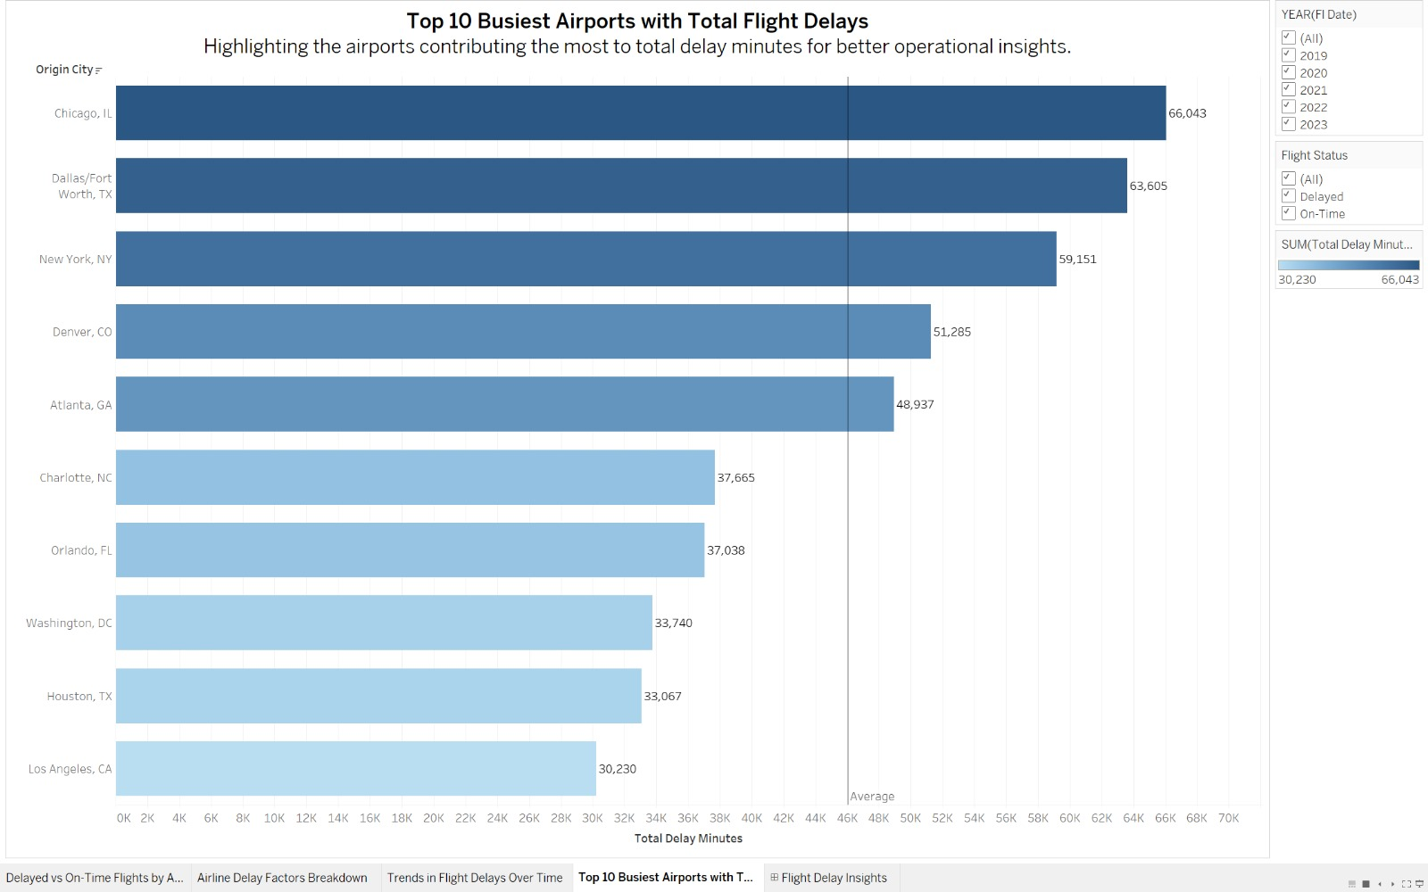
DATA VISUALIZATIONS

Slide 12
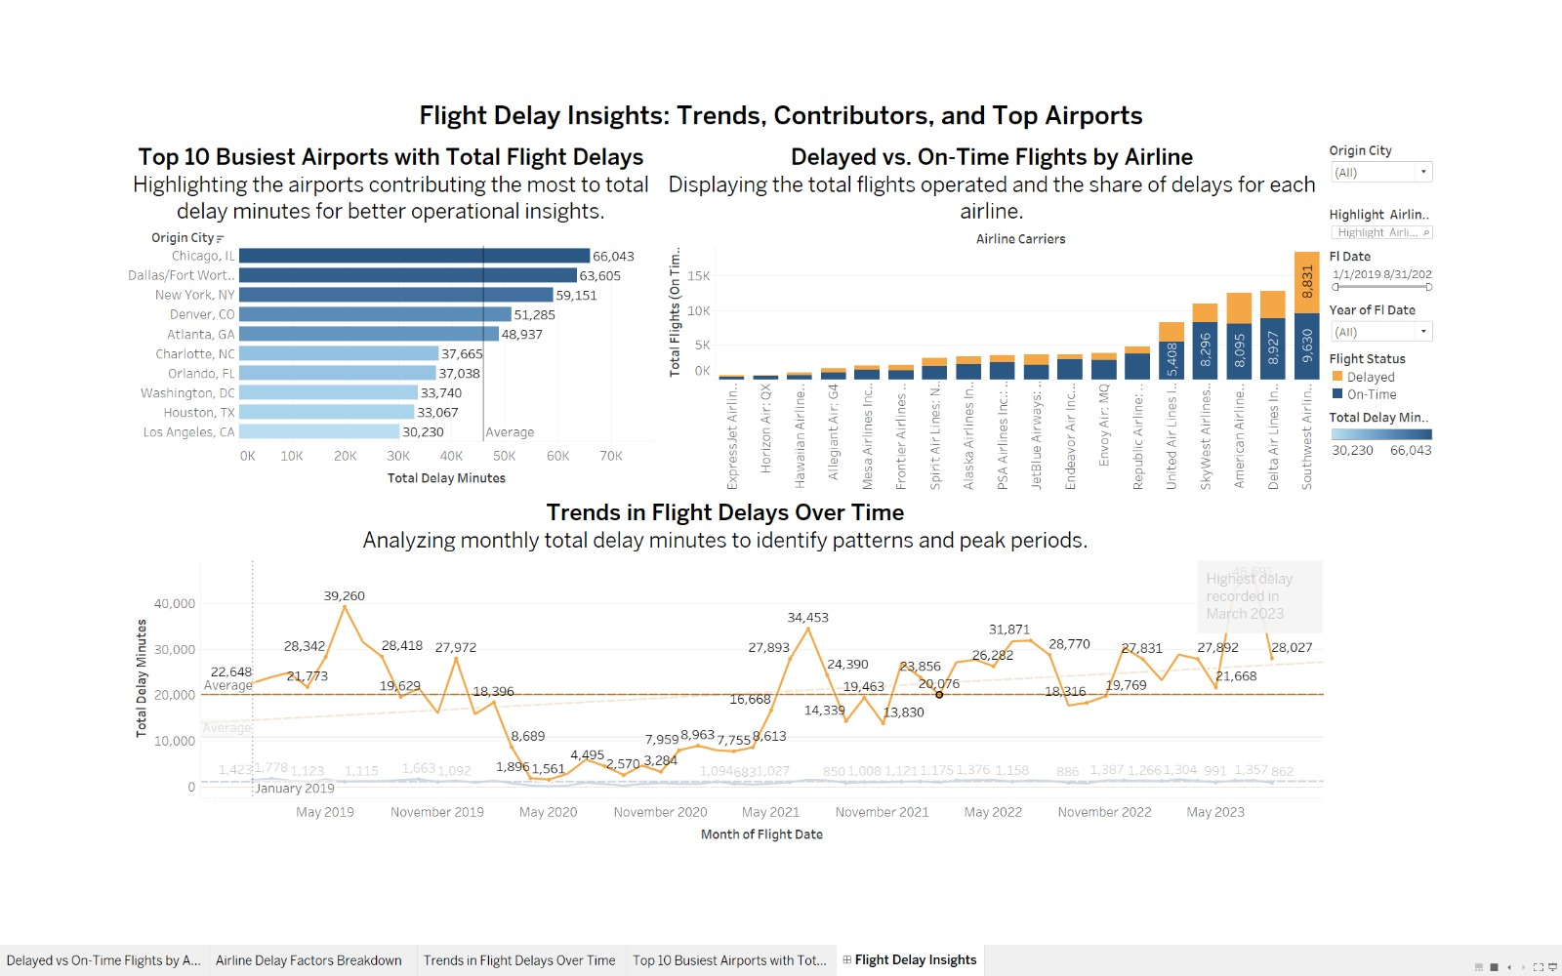
DATA VISUALIZATIONS

Slide 13

METHODOLOGY AND MODELS USED
RANDOM FOREST
GRADIENT BOOSTING REGRESSOR
SUPPORT VECTOR

Slide 14
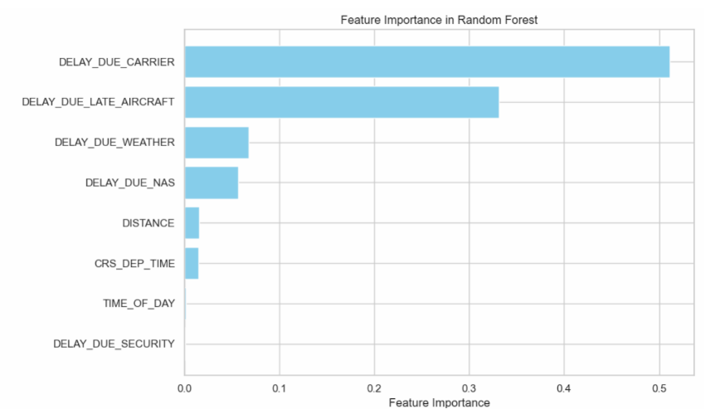
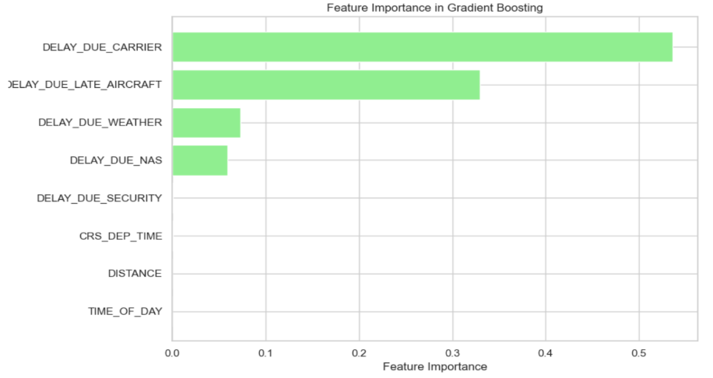
RANDOM FOREST
GRADIENT BOOSTING REGRESSOR
The analysis emphasizes that carrier delays and late arriving aircraft are the most critical factors contributing to departure delays. Addressing these issues, such as improving airline operational efficiency and minimizing turnaround times, could significantly reduce delays. Weather and NAS delays remain important but less dominant contributors, suggesting that external factors also play a role but are harder to control.
This insight is crucial for stakeholders, such as airlines and airports, to prioritize operational improvements and streamline processes to minimize delays.

Slide 15

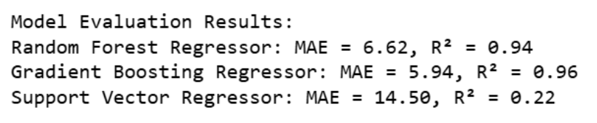


MODEL EVALUATION RESULTS
Random Forest Regressor
The Random Forest model performed exceptionally well, with an MAE of 6.62 minutes and an R² score of 0.94. This indicates that the model explains 94% of the variance in the delay data, making it highly accurate. The ensemble nature of Random Forest, which combines multiple decision trees, allows it to capture complex relationships between features like carrier delays and late aircraft arrivals, resulting in strong predictive performance.
Gradient Boosting Regressor
The Gradient Boosting Regressor outperformed the Random Forest model slightly, achieving a lower MAE of 5.94 and a higher R² score of 0.96. This suggests the model explains 96% of the variance, making it the best-performing model overall. By sequentially improving weak learners (decision trees) and focusing on correcting residuals, Gradient Boosting effectively captured both linear and non-linear patterns, particularly in features like weather-related delays and aircraft delays.
Support Vector Regressor (SVR)
The Gradient Boosting Regressor emerged as the most accurate model for predicting flight delays, closely followed by the Random Forest Regressor. Both models demonstrated excellent performance, with low errors and high R² values.
Support Vector Machine
The SVR model performed poorly compared to the other two models, with a significantly higher MAE of 14.50 minutes and a low R² score of 0.22. This indicates that SVR only explains 22% of the variance in the delay data. While SVR is effective for small datasets and non-linear problems, it struggled with this dataset's complexity, especially when handling features with high variability, such as carrier delays and late aircraft arrivals.

Slide 16



FLIGHT DELAY PREDICTOR
Using Gradient Boosting Regressor, the model with the best accuracy

Slide 17






TOOL FEATURES AND OUTCOME DEMO
This code performs flight delay prediction using a Gradient Boosting Regressor model and provides a user-friendly Tkinter GUI interface for interactive predictions.
Feature Selection and Model Training
GUI Setup with Tkinter
Data Preprocessing
A Tkinter-based interface allows users to input flight details: Passenger Name, Origin, Destination, Airline, Flight Distance, and Scheduled Departure Time.
Users enter flight details, and the trained model predicts the departure delay. Results are displayed in the GUI, showing the predicted delay in minutes.
The dataset `Flights Data.csv` is loaded using pandas. Missing values are handled and categorical values are encoded
Relevant features, including `DISTANCE`, `TIME_OF_DAY`, and delay causes, are selected. The dataset is split into 80% training and 20% testing, and the model is trained to predict flight delays

Slide 18

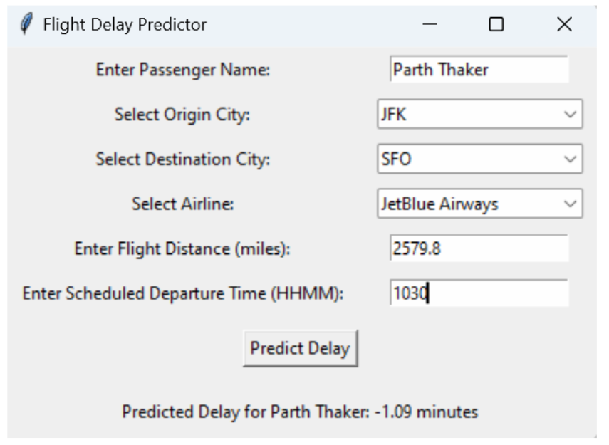




PR
Welcome to the Flight Delay Predictor
Traveling Date: 2024-10-12
Airline: Jetblue Airways
Flight Distance: 2579.8
Departure Time: 10.30 am
Origin City: JFK
Parth Thaker
1.09 Mins
Passenger
Expected Delay
Destination: SFO

Slide 19
FINAL COMMENTS
The models performed decently in predicting flight delays, with the Gradient Boosting Regressor performing the best. The results indicate that machine learning can be a viable approach to predicting flight delays.
Future Work: Given more time, the models could be improved by tuning their hyperparameters. With better programming skills, more advanced techniques could be utilized such as ensemble methods or more complex neural networks. Better data, especially incorporating weather conditions, could also improve the models. If better functions/algorithms were available, they could be used to enhance model performance.
Future Enhancement Areas: The models could be improved by using techniques to handle the imbalance in the dataset. More features could be engineered from the existing data. The project could also be expanded to include real-time prediction of flight delays.

Slide 20



Thank You!
+1 732 558-5006
pt439@scarletmail.rutgers.edu

